Slide 1
HUNGARIAN CASTLES

Slide 2
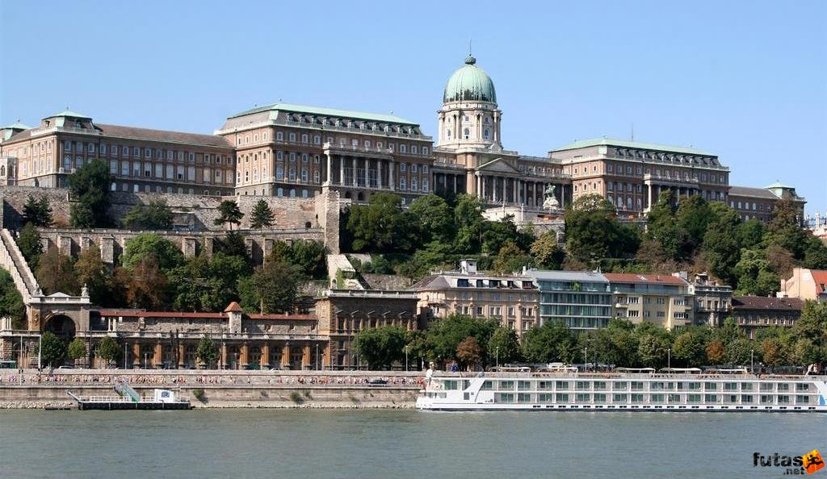
The Royal Castle of Buda
After the Mongol Invasion of Hungary in 1241-1242 attributed to the Tatars, Béla IV had a fortified town built on the Castle Hill of Buda.The Turks took the castle by ruse in 1541 and made it the centre of their Hungarian Province. After several unsuccesfull attemptsthe united christian armies took it back in 1686. The place was almost entirely destroyed during the siege.

Slide 3
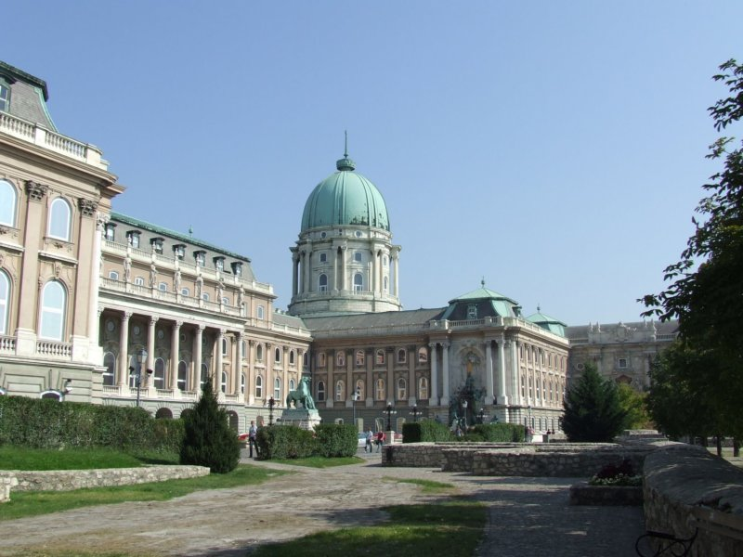
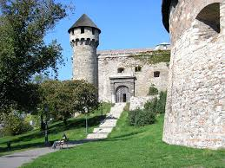
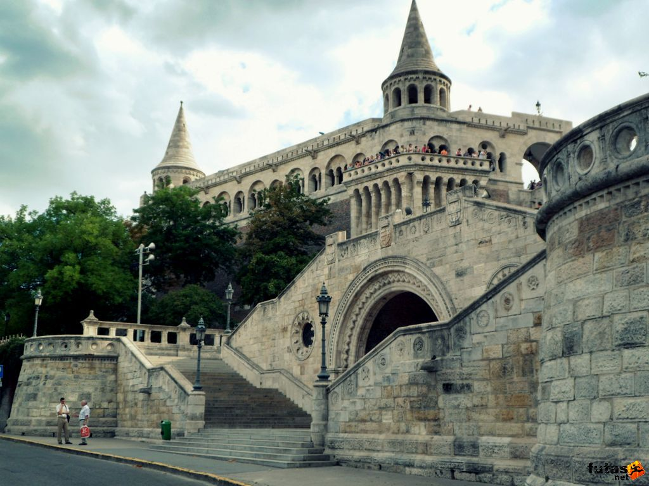
The royal place burnt down to the ground in World War II. It was rebuilt and turned into a cultural after the war

Slide 4
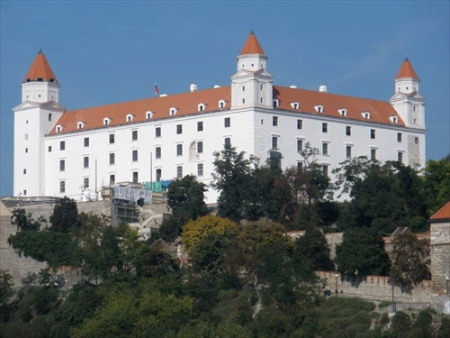
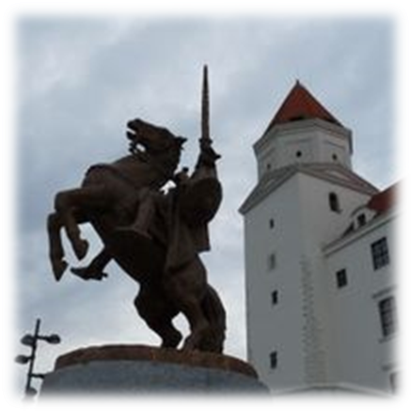
Bratislava Castle
Under King Stephen I of Hungary 1000-1038 the castle was one of the central castles of the Kingdom of Hungary.It became the seat of Pozsony county and orotected the kingdom against Bohemian (Czech)) and German attacks and played an important role in throne struggles in the kingdom of Hungary. The castle was turned into a proto-Romanesque palace of stone in the v12th cewntury maybe because King Béla III desided to make Esztergom the definitive seat of kings of the Kingdom of Hungary.
On 25 October in 1265 the Czech King, Premysl Otakar and the Hungarian King Béla IV.s grandchild Kunigunde, were engaded here. Andrew II and Gertrude’s daughter, Elisabeth was born here.
The crown, Sword and Globus Criciger of Hungary used to be kept in the Crowb of the castle Between 1552 and 1784 the holy of Hungary stayed in the castle.

Slide 5
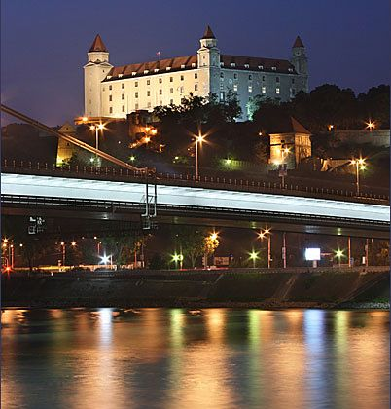
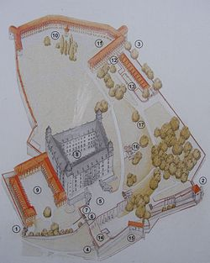
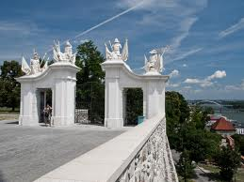
When Maria Theresa of Austria became the queen of the Kingdom of Hungary in 1740, she promised to the nobles of the kingdom that she would have a residence both in Austria and in the Kingdom of Hungary – that is in Pressburg Castle. She kept the promise and spent much time in Bratislava.
Since 1968, the castle has been housing exhibitions of the Slovak National Museum and at the same time its rooms have been used by the National Council of the Slovak Republic

Slide 6
Tata Castle
The first building of the castle at the Öreg-tó (Old Lake) was builty by the Lackfis in the second half of the 14th century. King Matthias rebuilt it to be one of the most beautiful Hungarian castles in late Gothic and Renaissance style. It became an important border castle against the Thurks from 1541 .The Habsburgs took it back in 1706 and burnt it down. József Esterházy purchased it in 1727 and had a modest palace built according to the palns of Jakab Fellner.

Slide 7
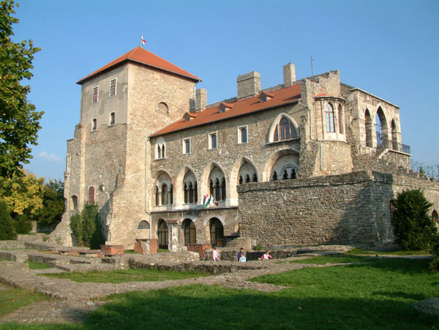
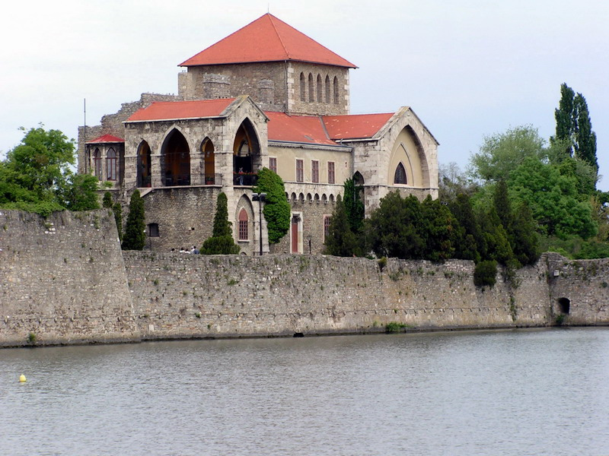
The Habsburgs took it back in 1706 and burnt it down. József Esterházy purchased it in 1727 and had a modest palace built according to the palns of Jakab Fellner.
The wing on the lakeshore still standingat that thime was rebuilt in Romantic style. It has been a museum since 1954. Its ruined wang has been excavated.

Slide 8
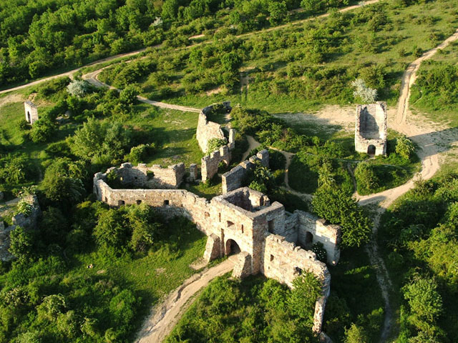
Eger Castle
Buildings of the Eger Cathedral and the Episcopal See were probably fortified as early as the reign of St. István. The centree of the episcopate was ravaged and burnt clown by the Tatars in 1241. The castle went over into Ferdinand’s possessin in 1549, who designated István Dobó to castellanship Dobó continued the fortification work. The bravely fighting defenders of the castle flung back the Türkish army to disengage Despite that the castle was almost in ruins, its reconstructions started in 1553, even new bastions were built.The castle surrendered, to Rákóczi only after a siege of eight weeks in 1705.

Slide 9
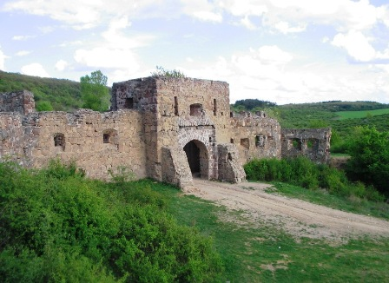
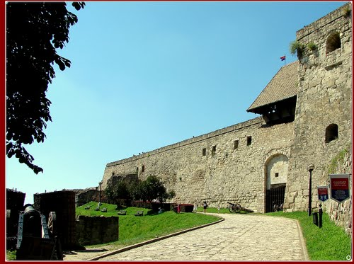
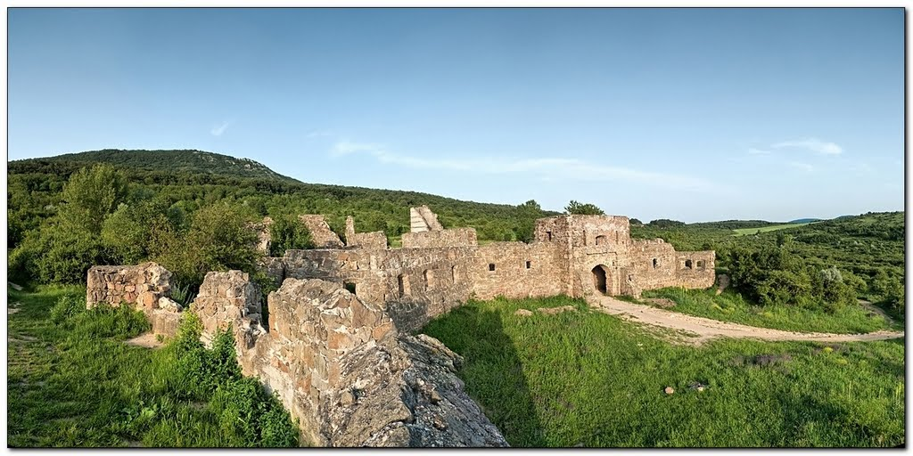
It was Rákóczi’s last bulwark until 1710 when it eventually had to be handed over. From that time the castle started to decay. It was turned into a museum after its reconstruction in the 20th century

Slide 10
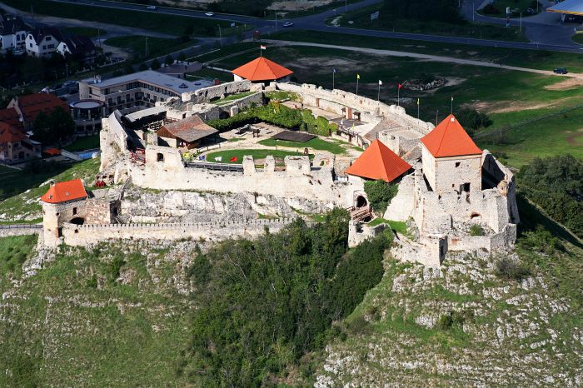
Sümeg Castle
The Bishop of Veszprém had a castle erectedon on the mountaintop of 270 meters high in the second half of the 13th century. After King Matthia’s death, the pretender Miksa Habsburg took it but Pál Kinizsi took back from him in 1491. After the fall of Veszprém, Sümeg became the Episcopal See from 1552. The castle was too strong for the Turks to assault.

Slide 11
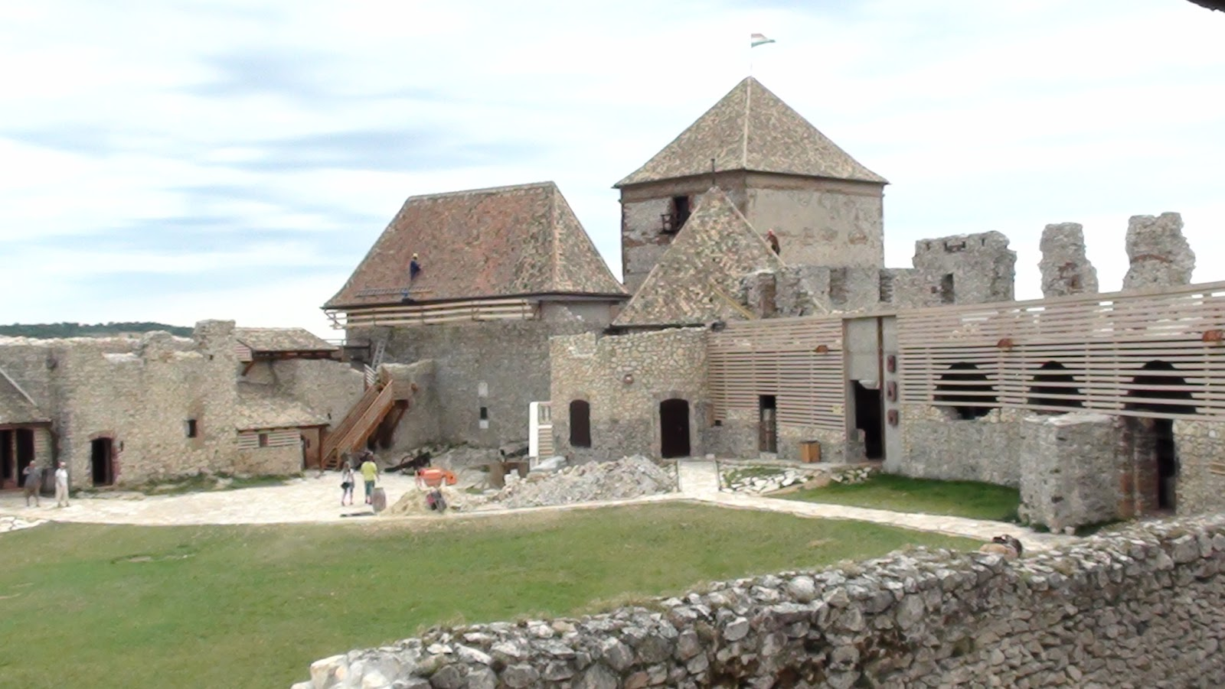
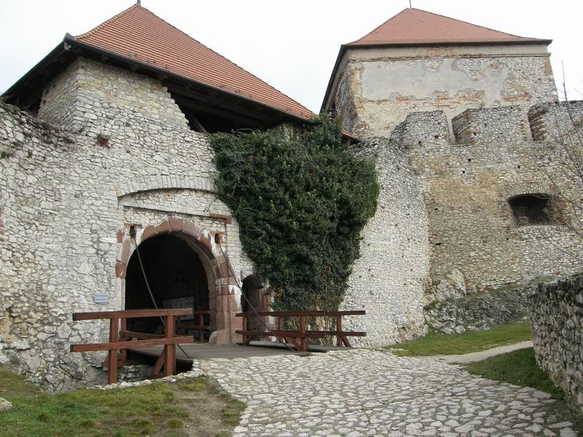
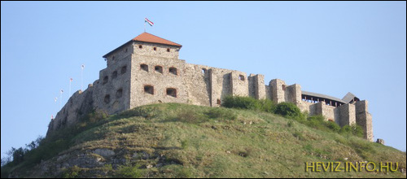
The last Turkish assault took place in 1664 when the town fell but the castle held out, even tough the building burnt down. The Kuruc troops took possession of it in 1705-1709 from whom the Hasburgs captured the castle with the help of traitor. They were garrisoned there until 1713 then they burnt it down. There is also a restaurant and a smithery in it and the Castle Days take place there every summer

Slide 12
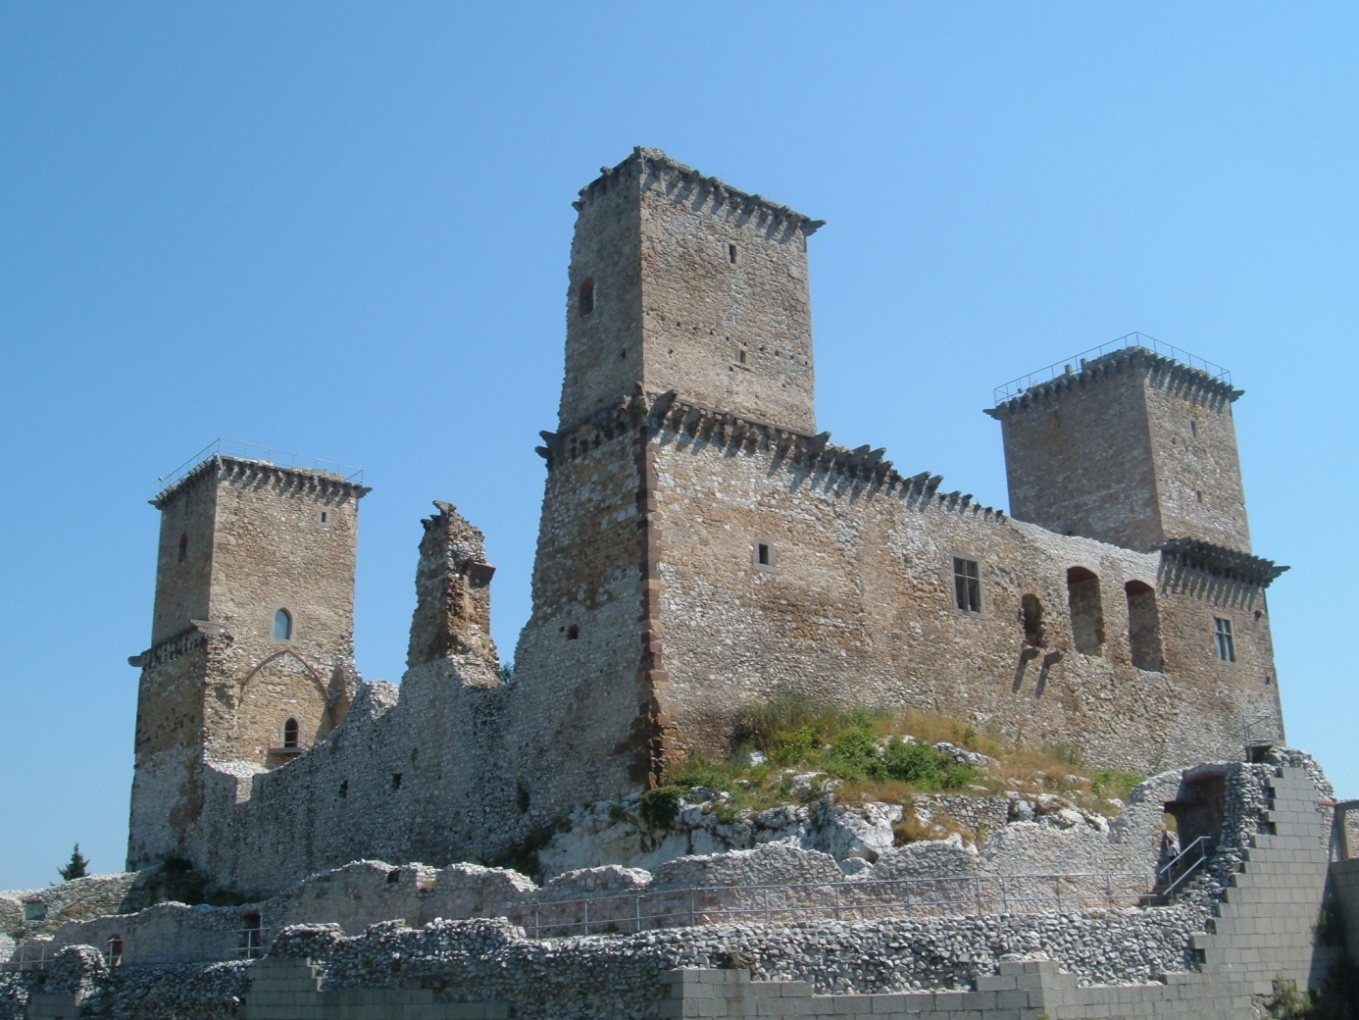
Diósgyőr Castle
Platine István, son of Ernye of the Ákos clan had a castle built of oval trace on a rock, near his mansion in Diósgyőr in the beginning of the 14th century that was called Újvár. Louis the Great had a Ghotic castle palace built with an enclosed court and four corner turrets in the place of the previous castle demolished upon his order. King Sigismund granted it to his wife Borbála in 1424 then six queens possessed it as an engagement gift in the last centurised of the Midle Ages. The castle often changed hands in the second half of the 16th century and it came under Turkish rule for a while in the Fifteen Year’s war.

Slide 13
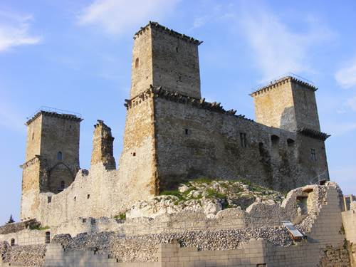
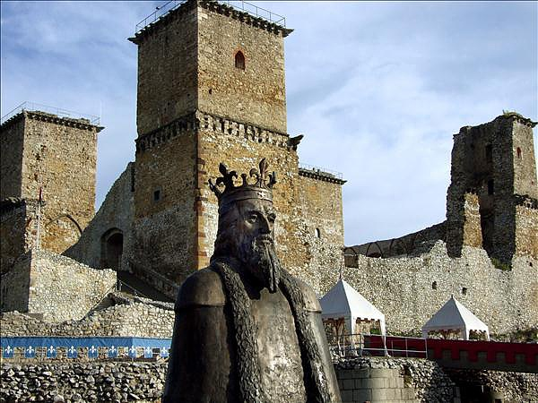
Howewer, it was again in Hungarian hands in 1605. The castle was already in runs at the end of the 18th century. Now it hosts a castle mueseum and many events.

Slide 14
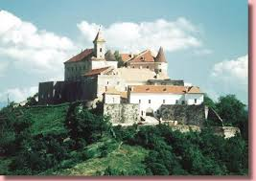
Munkács Castle
The castle was built in the second half of the 13th century. Charles Robert got hold of it in 1312 than gave it ti his wife. It often chenged hand , between King János and FerdinandI after the battle of Mohács. The Rákóczis obtained it through marriage. It was an important bulwark of Ferenc Rákóczi II . It was turned into a prison of the Habsburg Empire. Now it is a museum.

Slide 15
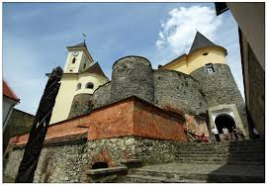
It was an important bulwark of Ferenc Rákóczi II . It was turned into a prison of the Habsburg Empire. Now it is a museum.

Slide 16
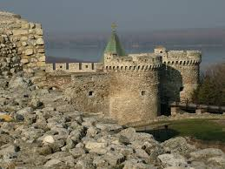
Beograd Castle
King Salamon assaulted the castle in 1071 together with Duke Géza and László. The Greek castellan, Niketas resisted fiercely but when a Hungarian girl had set the lower town on fire he gave up the citadel.The castle went over into Byzantine possession again in the next year István II pulled it down in 1127 but Emperor Manuel rebuilt it in 1151.

Slide 17
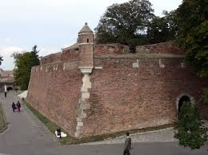
The castle was a crucial part in the southern defence line of Hungary. Sultan Mohamed besieged it with an enormous army in 1456, but Mihály Szikágyi and János Hunyadi beat off the sultan’s attack wih an army of crusaders gaining a glorious victory. The castle was an awesome bastion against the Thurkish meniscus.

Slide 18
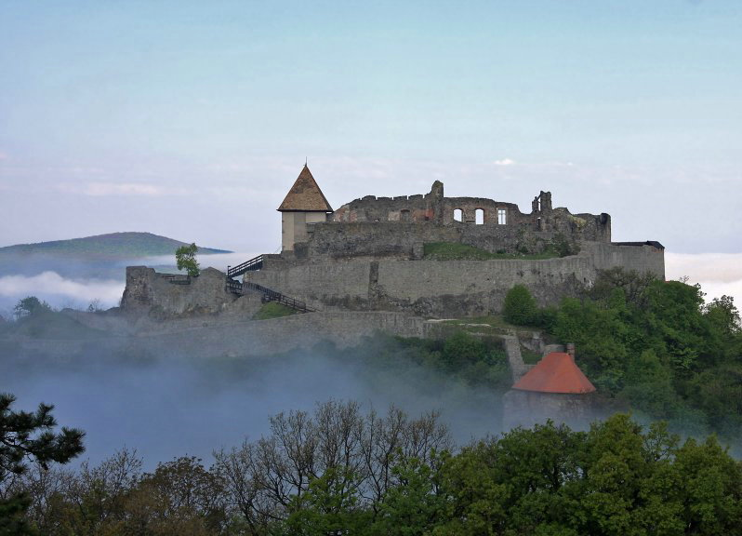
Visegrád Castle
The tatars destroyed the castle of visegrád in 1242, which was then a fortress built on the remnants of a Roman castrum dating back to the 4th century. Béla IV and his wife ordered a new castle to be built on a neighbouring hill, in the place of an ancient earthwork. The King made it his seat in 1323, enlarged and fortified the castle. From that time the crown and the regalia were kept in this castle for twor hundred years by first and starts. The widow of Albert Habsburg had the crown stolen in 1440 k. King Matthias had the citadel rebuilt in the 1470-80’s. The garrison fled from the castle when the Turks marched to the walls in 1526 but the local people and the monks of Márianosztra held it against the Turkish assault.

Slide 19
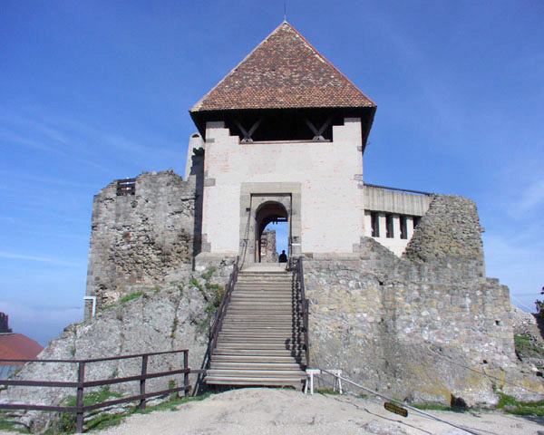
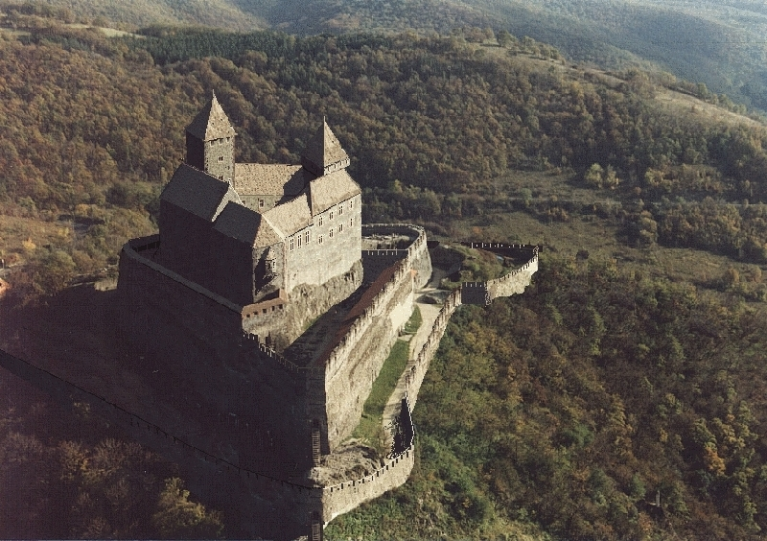
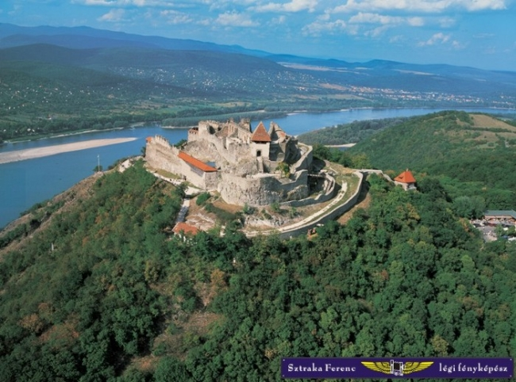
Ferdinand finally took ot but the Turks captured it in 1544. the Habsburgs recaptured the castle in 1595 that gradually became ruinos and uninhabited. It was renovated in 1601 and mercenary troops were comissioned to defend it. When Károly Lorrainese captured it in 1684 the Turks stroke back by recapturing the fortress in 1685. the united European armies liberateed the ruinos castle demilitarised by the Turks in 1686.

Slide 20
Esztergom Castle
It was Prince Géza who had the first medieval xcastle built on the ruins of a Roman bulwark. His son St. István was born here between 969 and 975, who established an archiepiscopacy in the castla at the millenium. Bailiff Simon managed to hold the fortification against the siege of the Tatars in 1242. It was only Achbishof Csanád telegdi who had the see reconstructed in the 1330’s and 40’s after having been sorely tried in the internal strugless of the decades around 1300. The caastle withstood the assault of Sulejman II for 17 days in 1543 only surrendering after the water supply had been cut off. The Christian armies besieged the castle without success. Bálint Balassi was killed in action here. Howewer, the castle was retaken in 1595 only to fall into Turkish hands again ten years later. It remained undeer Turkish rule for 80 years from 1605. The polish King János Sobieski liberated the castle with an international army in 1683. Ruins of the medieval palace were found in 1934 and were opened to public in 1938.

Slide 21
