Slide 1
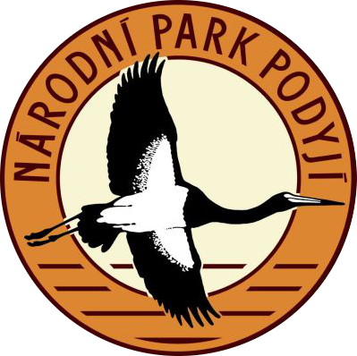
National Park Podyji

Slide 2
Information
Podyjí National Park is one of the four national parks of the Czech Republic.
Podyjí National Park with an area smallest national park in the Czech Republic. It has an area of 63 square kilometres and buffer zone of 29 square kilometres.
It was formally declared a national park 1 July 1991.
On the Austrian side it adjoins Thayatal National Park.
Podyjí National Park is located along the river Dyje flowing through 40 km long, deep meandering valley.

Slide 3
Map of National park Podyji

Slide 4
Vegetation
Podyjí National Park has a high biodiversity.
Occurs there seventy-seven kinds of protected plants - kýchavice černá, měsíčnice vytrvalá, brambořík nachový, divizna nádherná, koniklec velkokvětý, iris dvoubarvý, volovec vrbolistý, 18 species of orchids and more.
Interesting communities: scree fields, covered with mosses and lichens, rich wetland and dry meadows, rocks, rocky steppes, unique in Europe area dry and warm heaths.

Slide 5
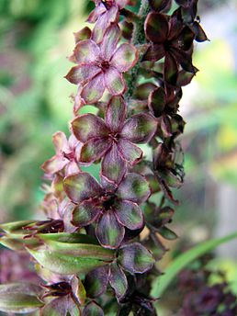
Black Hellebore (Veratrum nigrum) (Kýchavice černá)
Very rare and and critically endangered. It is growing only at a few locations in warm areas

Slide 6
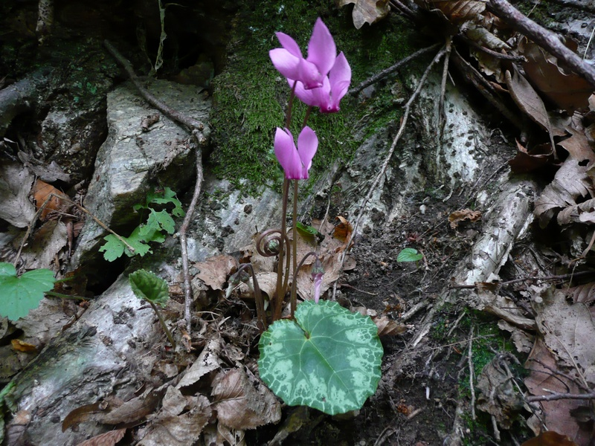
Cyclamen (Primulaceae) (Brambořík nachový)
Normal plant in National Park

Slide 7
Animals
From the richly represented animals live in the park, river otter, common ground squirrel.
Rare birds representing hoopoe, black stork, eagle owl, dipper and more..
Insects are represented elsewhere many rare species, such as the stag beetle, praying mantis, beetle huge, rhinoceros, swallowtail fruit, Clouded Apollo and others.
In the river occurs 32 kinds of fish - especially trout, grayling and brook trout. Mammals in the park about 65 species - otters, bats, bird species ... there are 152. 7 species of reptiles, amphibians and significant representation.

Slide 8
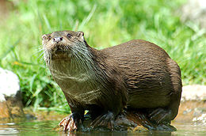
Otter (Lutra lutra) (Vydra říční)
Amply represented in National Park. Its the only species of otter in The Czech republic

Slide 9
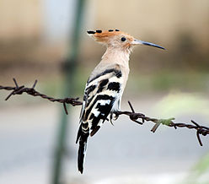
Hoopoe (Upupa epops) (Dudek chocholatý)
Highly endangered bird species in Podyjí

Slide 10
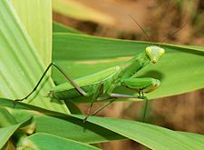
Praying mantis (Mantis religiosa) (Kudlanka nábožná)
It´s the only species in Czech republic

Slide 11
Negative impact on the Thaya
Negative impact on the fauna of the river Thaya has two large dams on the edges of the protected part of its course. The upper edge is that Vranovská dam and the lower Znojemská. These structures affect the temperature conditions in the river are also insurmountable barrier for migrating animals. Due to the cold water flow from the dam has changed the flow of the Thaya on trout zone, and the later emergence of Znojmo dam completely displaced and typical species such as the Common Nase and such.. Even so, it was found in the river 32 kinds of fish - especially trout, grayling and brook trout

Slide 12
And that´s all. Come and visit Podyjí!

