Slide 1
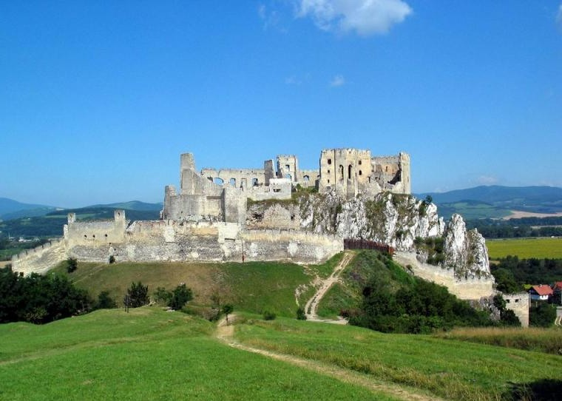
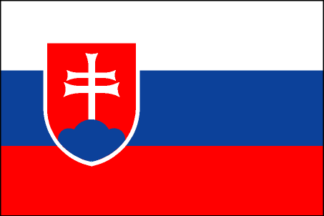
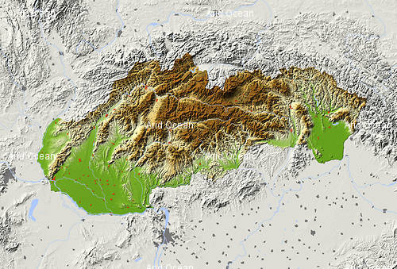
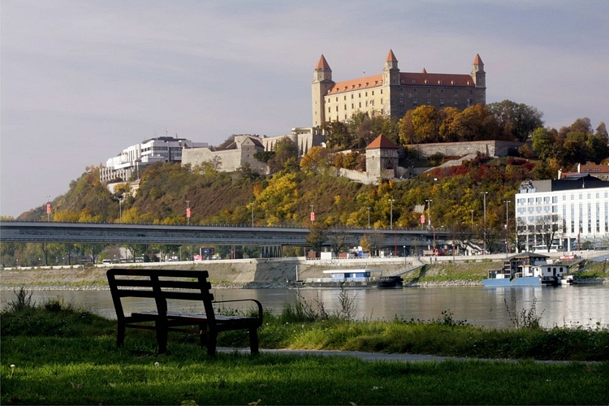
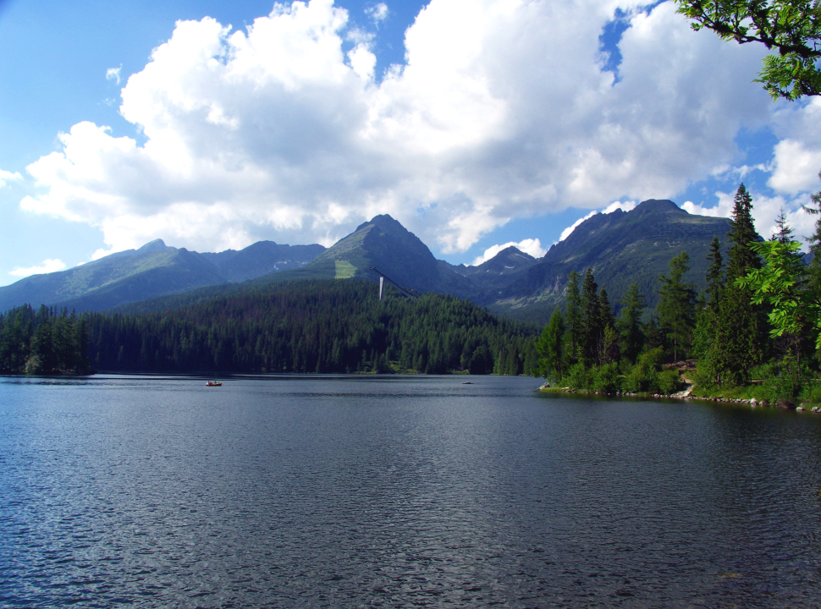
Slovakia
QUIZ

Slide 2
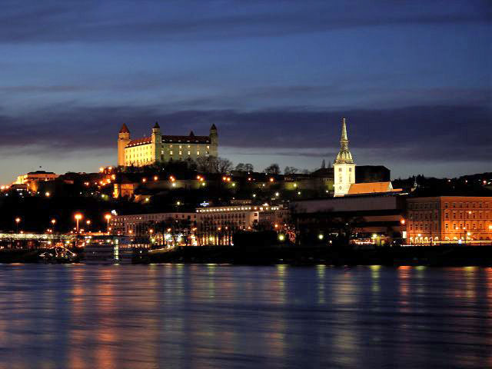
Which is the capital city of Slovakia?
Prague
Paris
Bratislava
Budapest

Slide 3
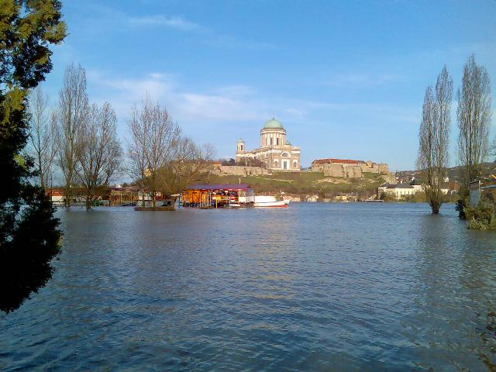
Which river flows in Slovakia?
Danube
Kongo
Nile
Amazon

Slide 4
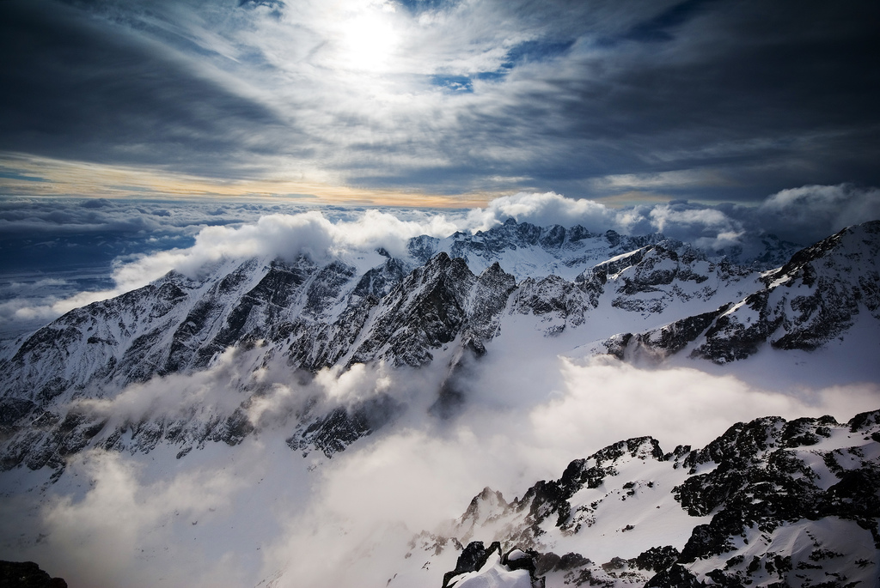
Which mountains
are in Slovakia?
Alps
High Tatras
Andes
Himalayas

Slide 5
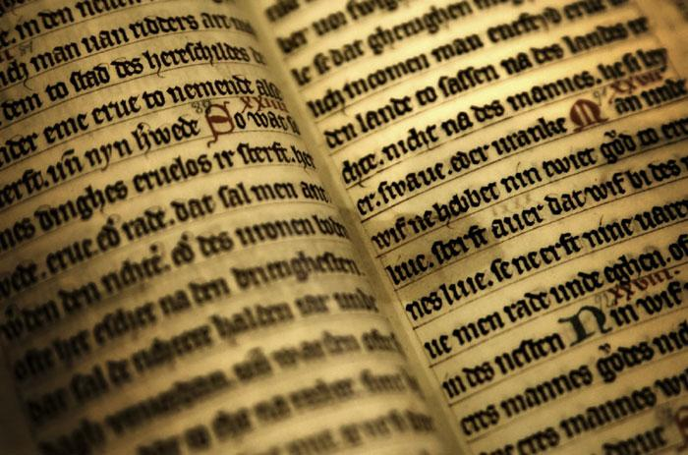
Which language is
official in Slovakia?
English
France
Slovak
German

Slide 6
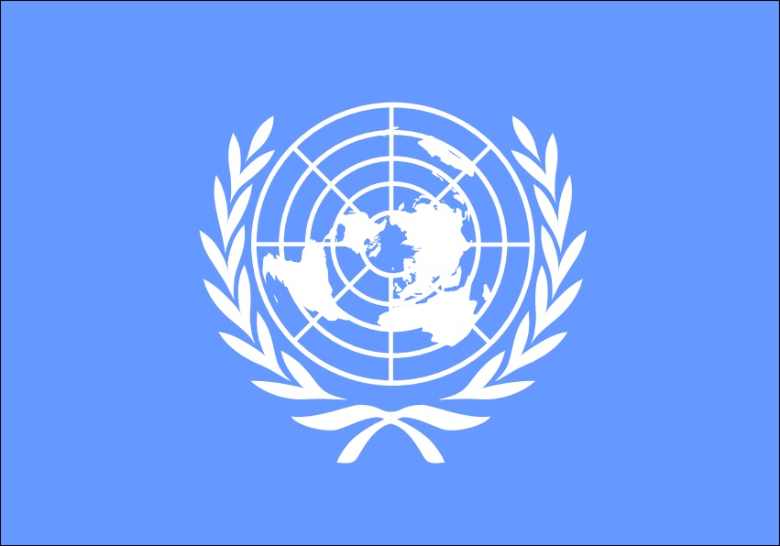
Which is a Slovak flag?

Slide 7
Which colors is the slovak flag composed of?
Green,blue,white
Red,white,red
White,blue,red
Blue,red,green

Slide 8
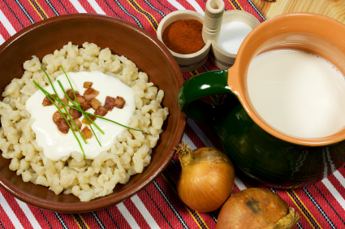
Which is the typical food in Slovakia?
Hamburger
Sheep cheese dumplings
Sushi
Pizza

Slide 9
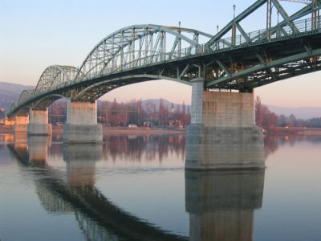
Štúrovo lies
on the river:
Labe
Tisa
Rhine
Danube

Slide 10
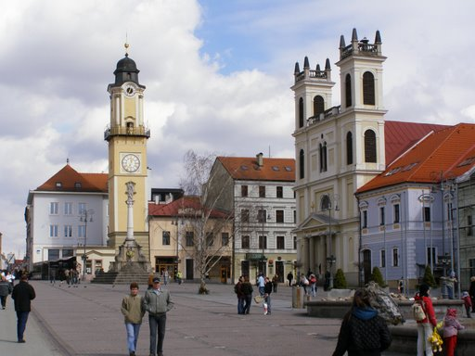
Which religion is predominant in Slovakia?
Muslim
Jewish
Roman catholic
Buddhism

Slide 11
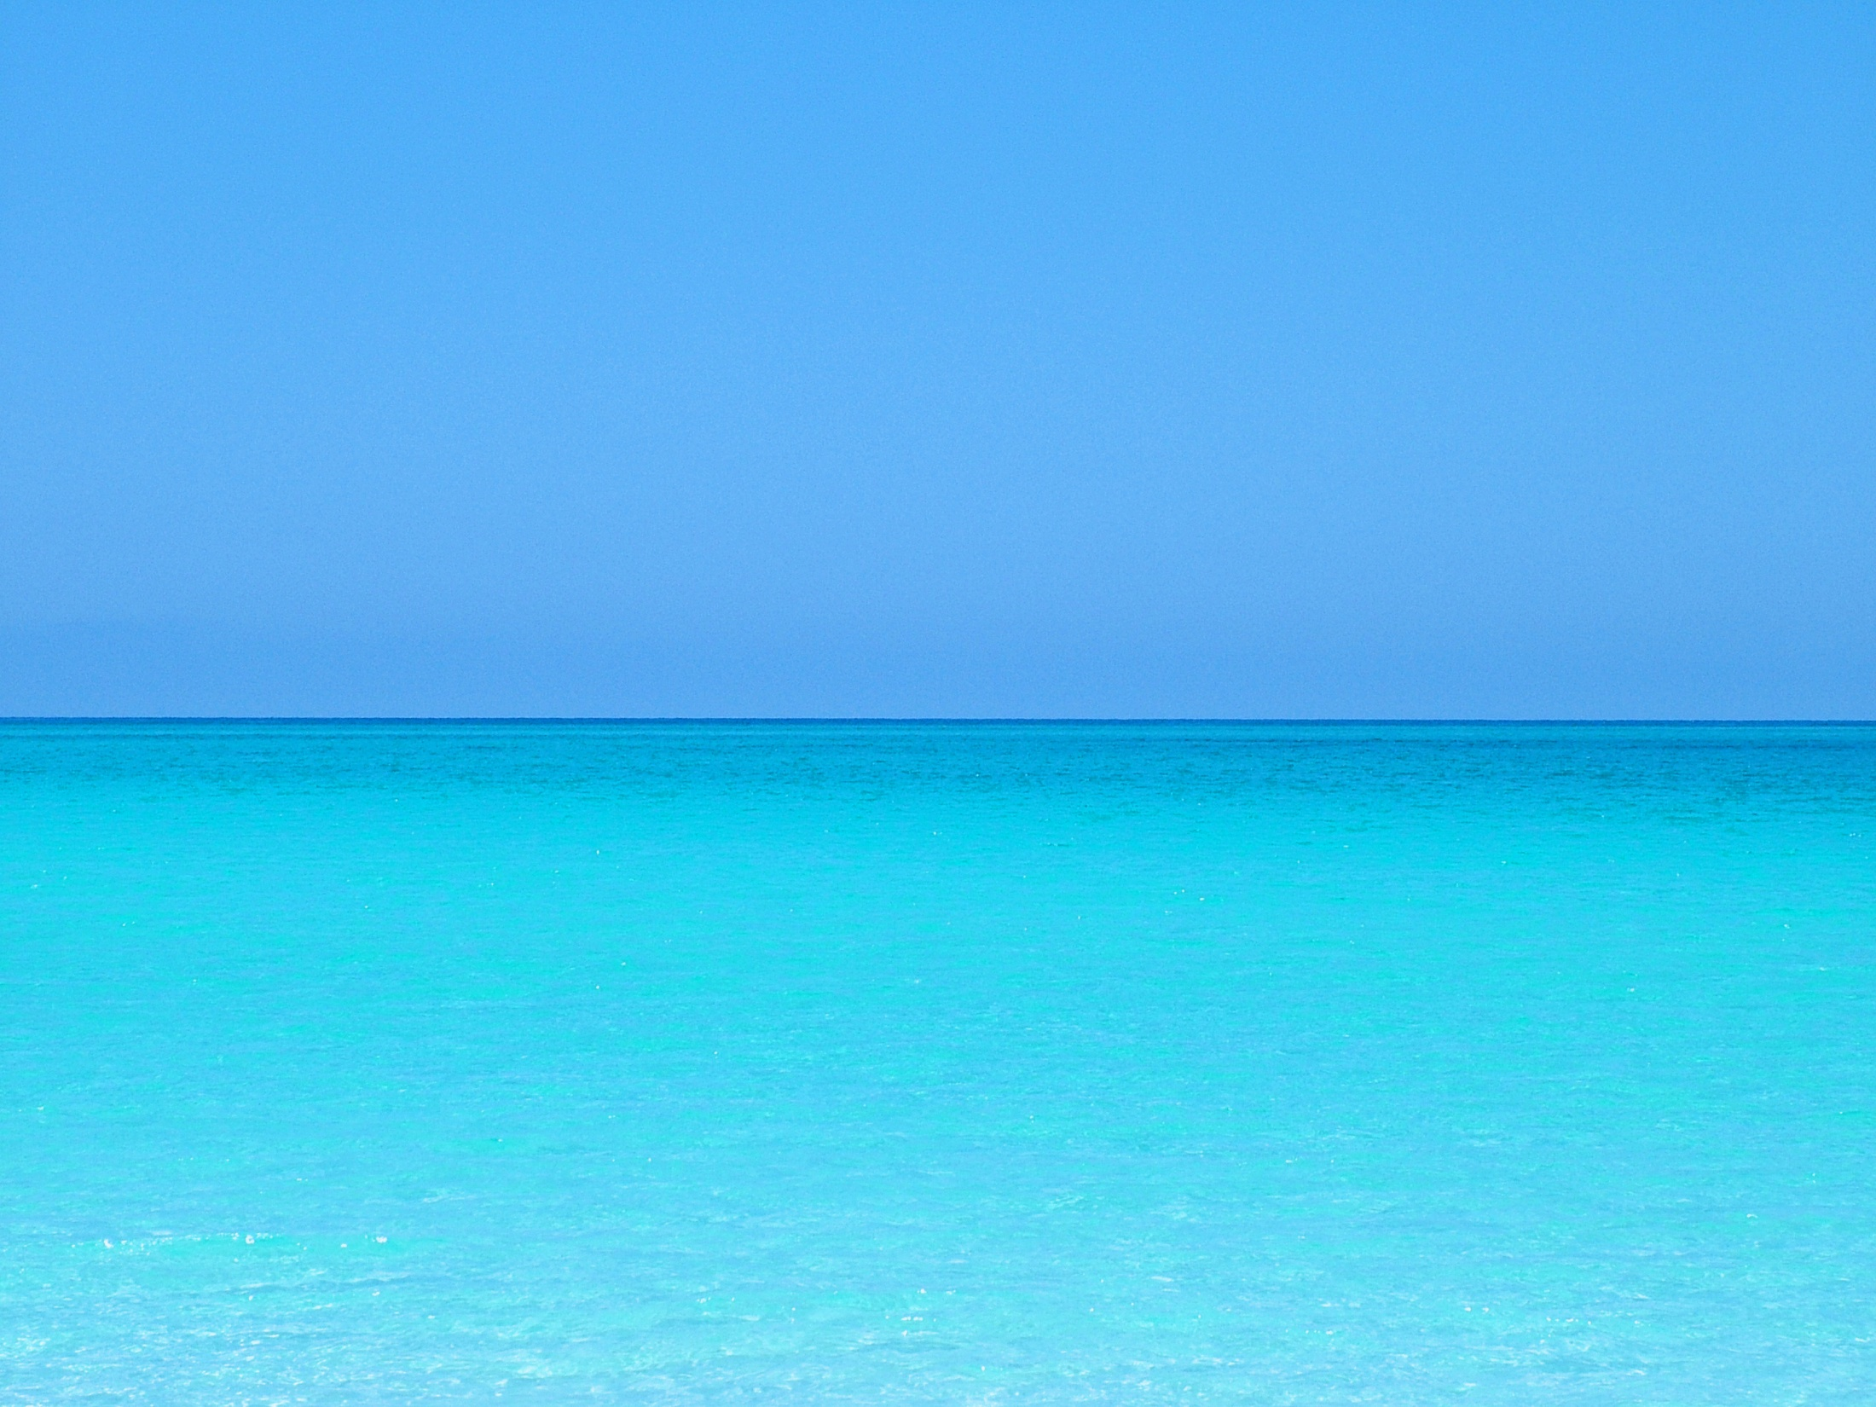
Which sea is in Slovakia ?
Mediterranean
There is no sea
In Slovakia
Baltic sea
Black sea

Slide 12
Your points:
10-9=
8-7=
6-5-4=
3-2=
1-0=
Click and count your points…
1
2
3
4
5

