Slide 1
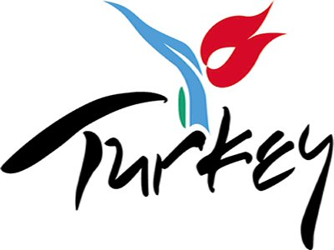
Test about

Slide 2
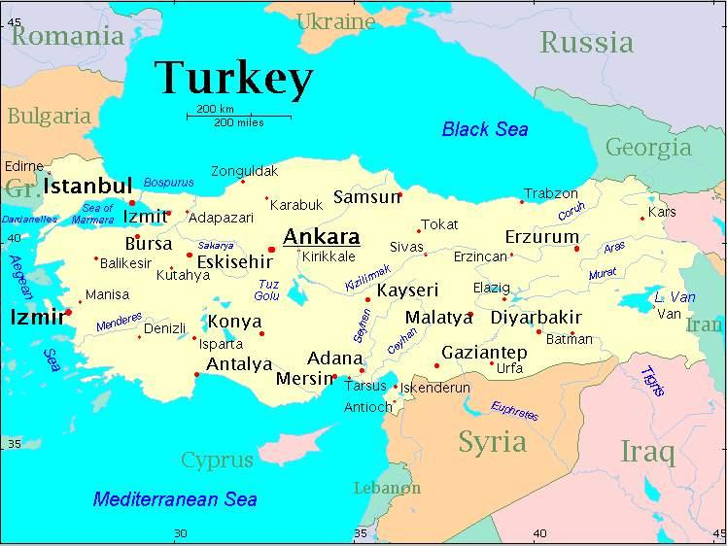
What is the capital city of Turkey?
Istanbul
Ankara
Paris
Rome

Slide 3
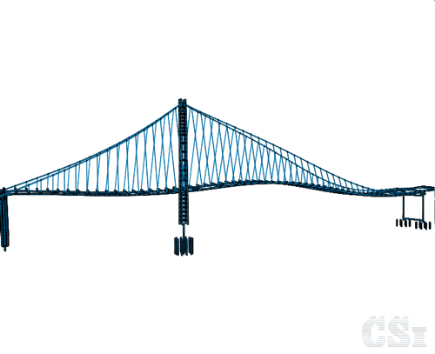
What is the name of the bridge which connects Asia to Europe?
London Bridge
Chain Bridge
Bosphorus Bridge
Stone Bridge

Slide 4
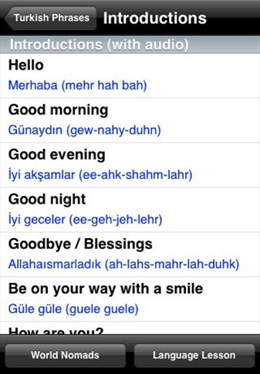
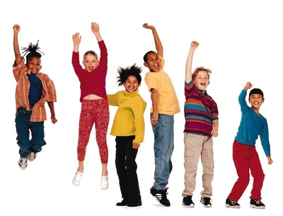
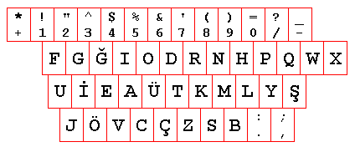
What is the official language in Turkey?
English
French
Arabic
Turkish

Slide 5
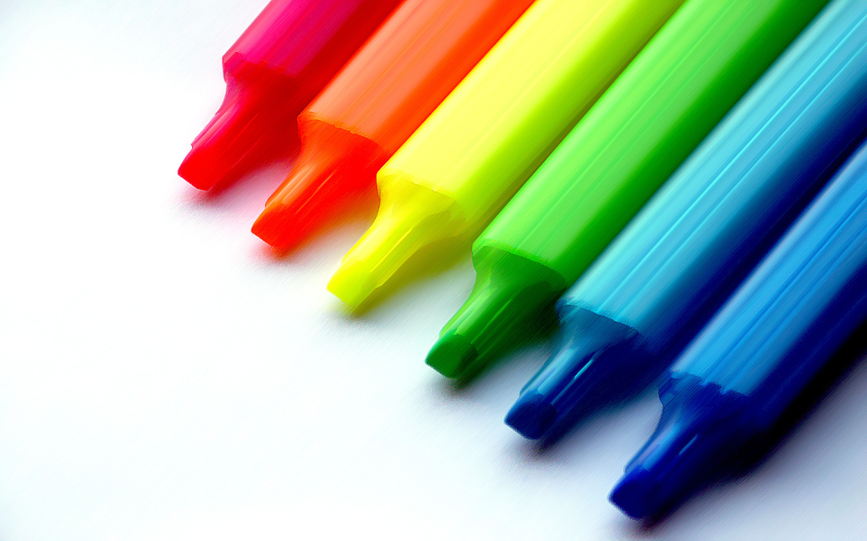
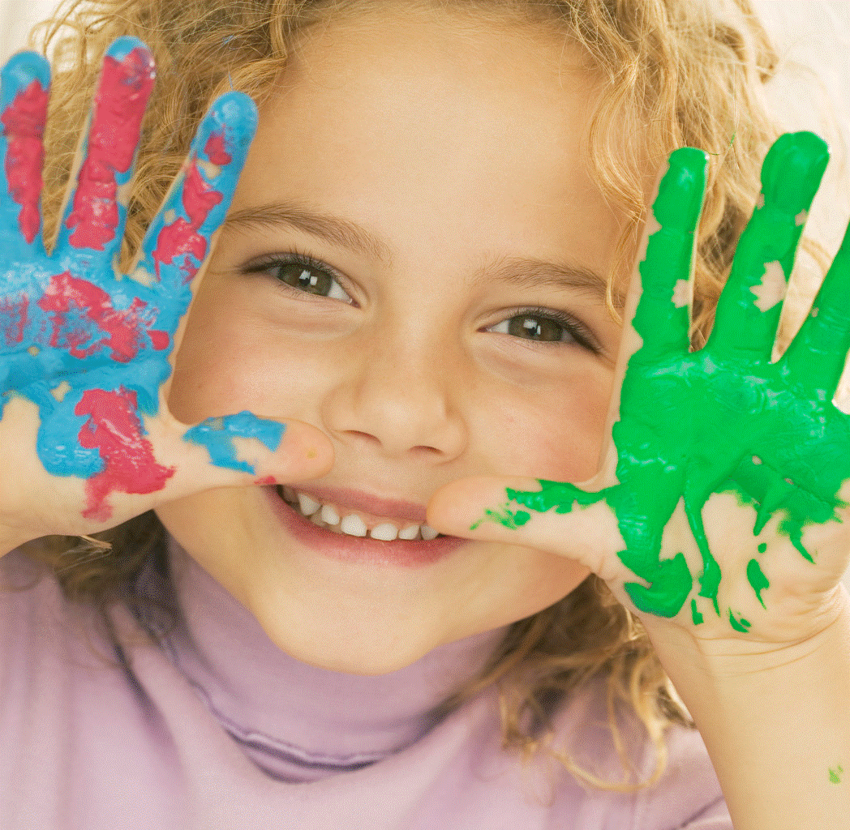
What Color is the Turkish flag?
Red&White
Red&Blue
White&Green
White&Blue

Slide 6
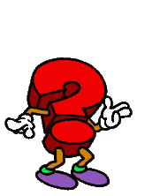
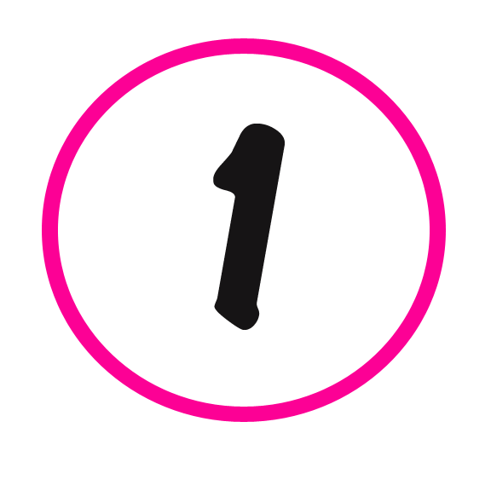
How many regions are inTurkey?
six
seven
eight
nine

Slide 7
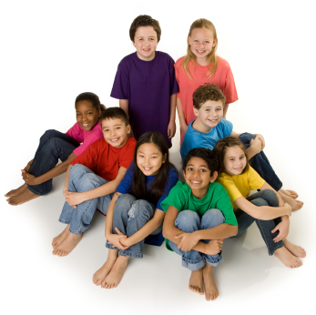
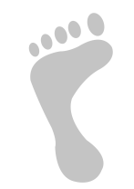
Which is the most croeded city inTurkey?
Ankara
Antalya
Istanbul
Izmir

Slide 8
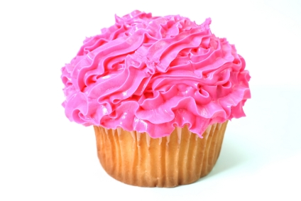
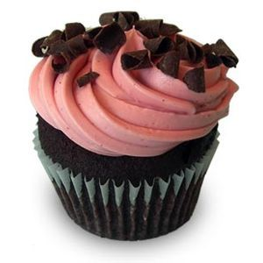
What is the most popular desert in Turkey?
Pudding
Cheese cake
Pan-cake
Baklava

Slide 9
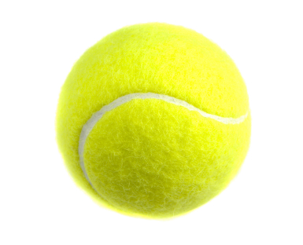
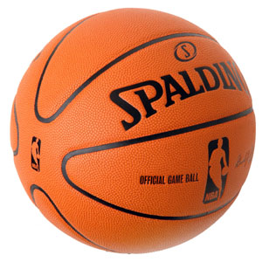
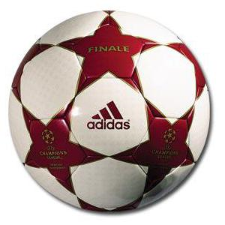
What is the most popular sport in Turkey?
Football
Basketball
Ice-hokey
Tennis

Slide 10
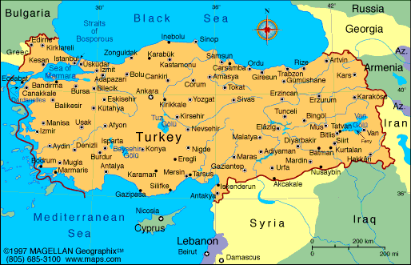
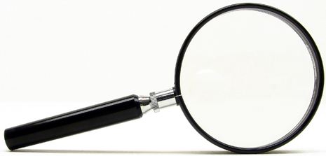
Who is the founder of Turkish Republic?
Lenin
C.F. Kennedy
Roozvelt
Mustafa Kemal Atatürk

Slide 11
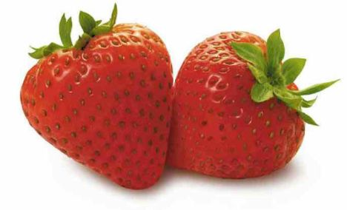
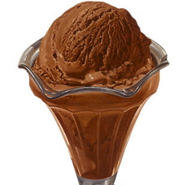
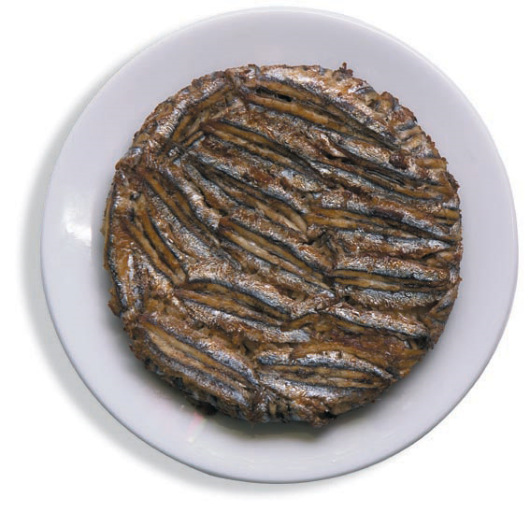
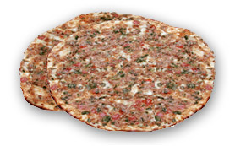
What is Adana famoust for?
Hamburger
Cheeseburger
Kebab
Fried cheese

Slide 12
Your points...
10 points →Excelent
9-8 points →Great Job
7-6-5 points → Good Job
4-3-2 points → Good
1-O points → Try again
The end

