Slide 1
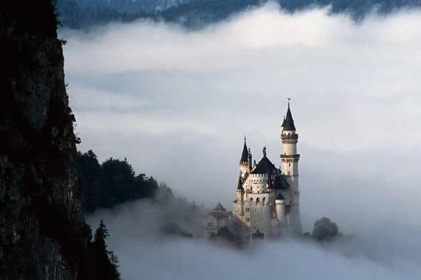
Castels in Poland

Slide 2

In Poland there are 419 beautiful castles and 2021 palaces. One of them, the Castle of Teutonic Order in Malbork is listed by UNESCO as a special cultural significance
In this presentation we are going to show you 10 most popular castles and palaces.

Slide 3
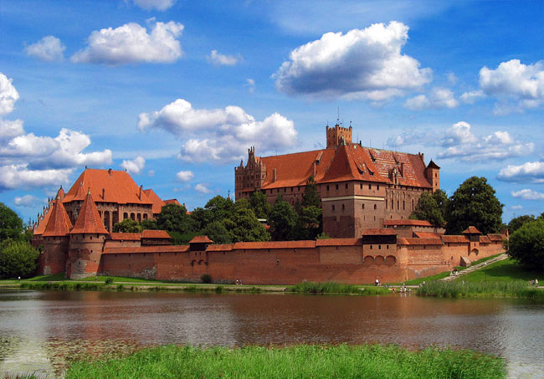
The Castle of Teutonic Order in Malbork
This is a defencive castle, it divided into three segments. It’s one of the biggest gothic castles in the world. From 14th September 1309 to 1457 the castle of Malbork was a headquarters of a great Tutonic Master, and the city was a capital of Teutonic Order. The orginal name of the castle used by Teutonic Order was Marienburg.

Slide 4
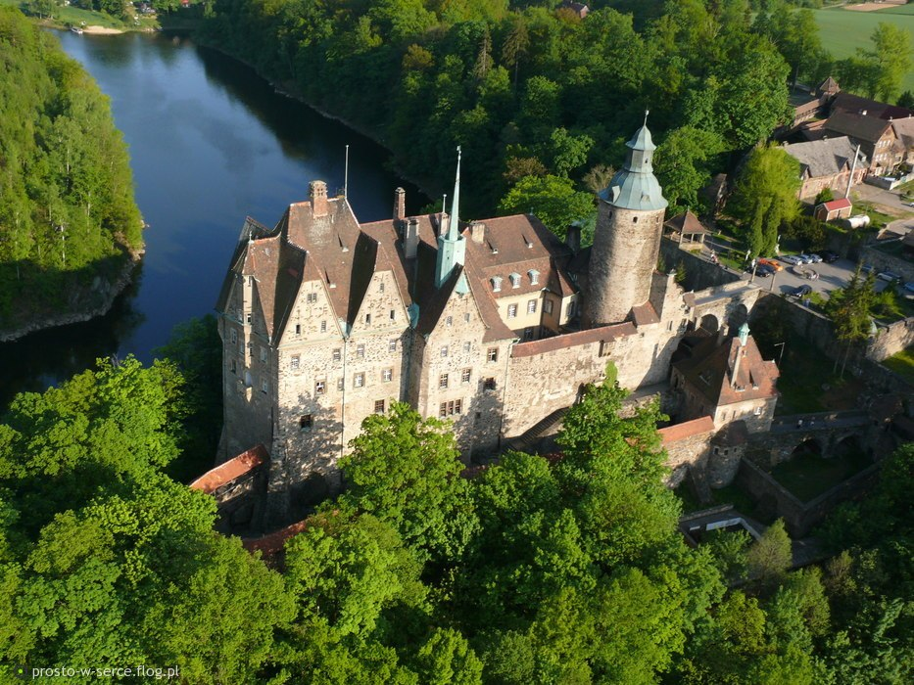
Castle Czocha
This is a defensive castle in the Czocha village, in Luban County. The castle is located on the Lake Lesnia, near the Kwisa river, in what is now the Polish part of Upper Lusatia. Czocha castle was built on gneiss rock, and its oldest part is the keep, to which housing structures were later added.

Slide 5
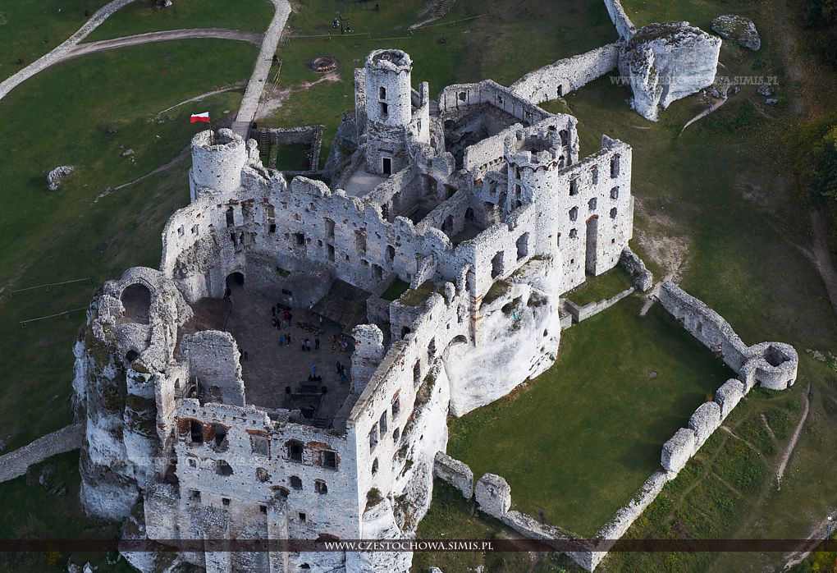
Castle Ogrodzieniec
Ruins of the medieval castle in the Kraków-Częstochowa Upland. Rebuilt several times in it’s history, the castle was originally built in the14th-15th century by the Włodkowie Sulimiczycy family. The castle is situated on the 515.5m high Castle Mountainm the highest hill of the Kraków-Częstochowa Upland.

Slide 6
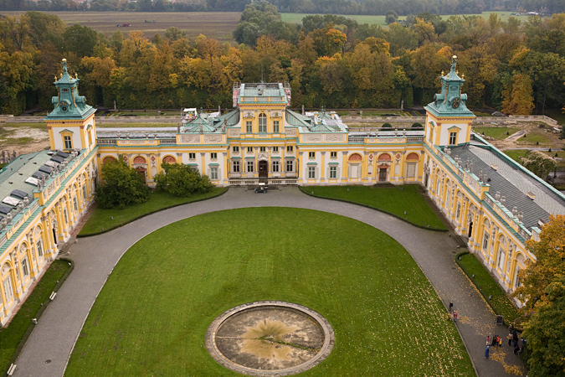
Palace in Wilanow
This is a royal palace located in the Wilanów discrit in Warsaw. This palace survived the Poland’s partitions and two World Wars.
It’s one of Poland’s most important monuments. The Palace museum, established in 1805, is a repository of the country’s royal and artist heritage.

Slide 7
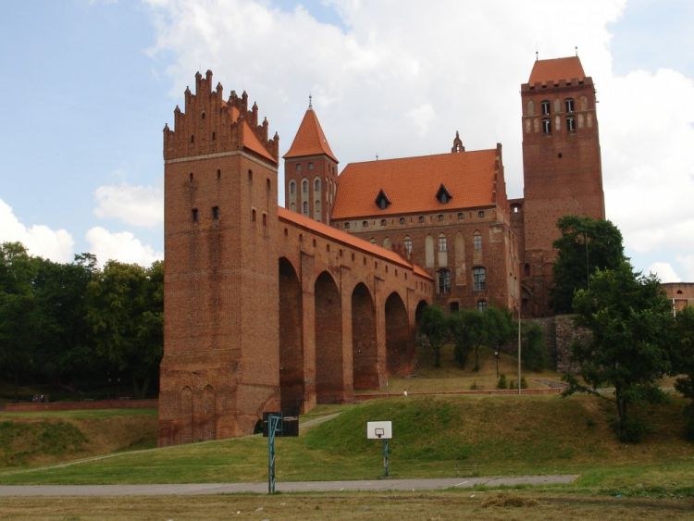
Castle Kwidzyn
It was built in the Gothic style, of brick laid on stone base. The construction works continued from 1300 to 1330.The castle wingswere fortified with square towers raised in each corner.The characteristic element of castle is the largest in the state of Teutonic Orderid tower defense

Slide 8
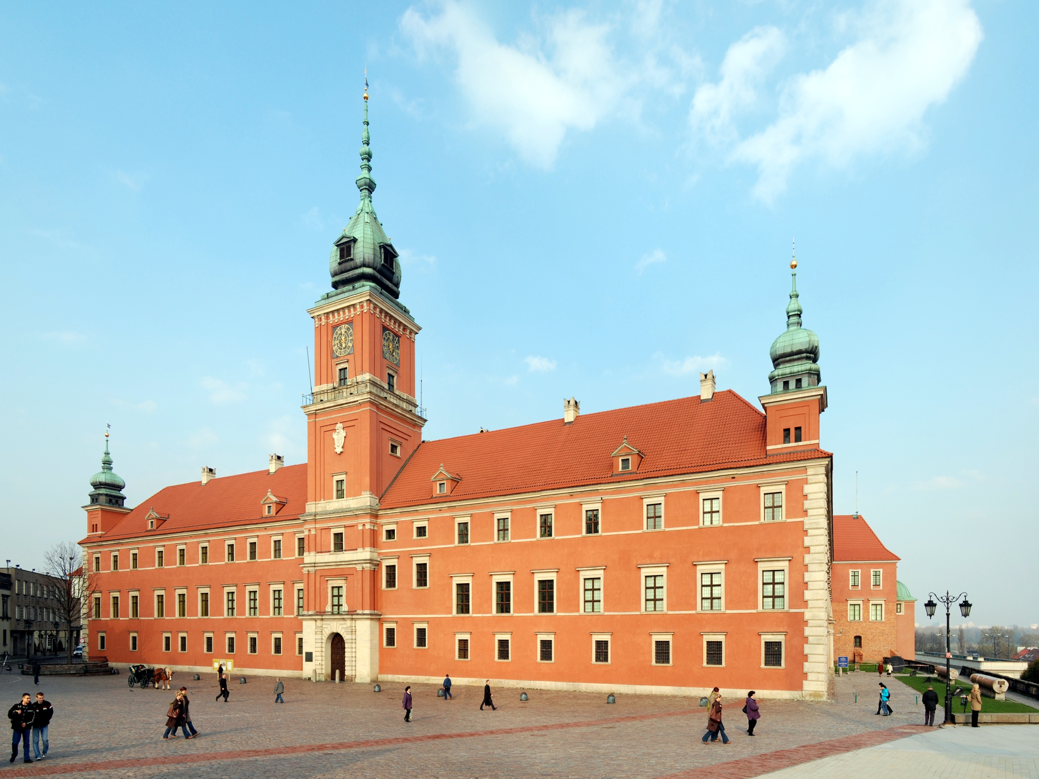
Royal Castle in Warsaw
This Castle was the official residence of the Polish monarchs. Now the castle serves as a museum. It’s located in the Castle Square, at the entrance to the Warsaw Old Town. In it’s long history the Royal Castle was repeatedly devasted and plundered by Swedish, Brandenburgian, German and Russian armies.

Slide 9
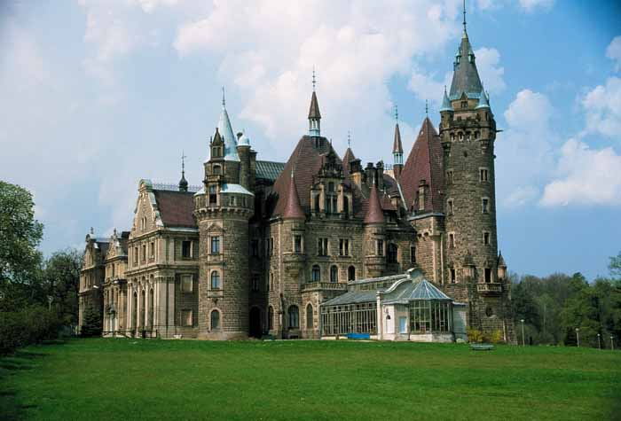
Castle in Moszna
It’s historic castle and residence, located in a small village of Moszna in Poland. The castle was established in the mid 17th century and is ona of the best known monument in the western part of Upper Silesia. From 1866 to 1945 the castle was residence od the Prussian family Tiele-Winckler.

Slide 10
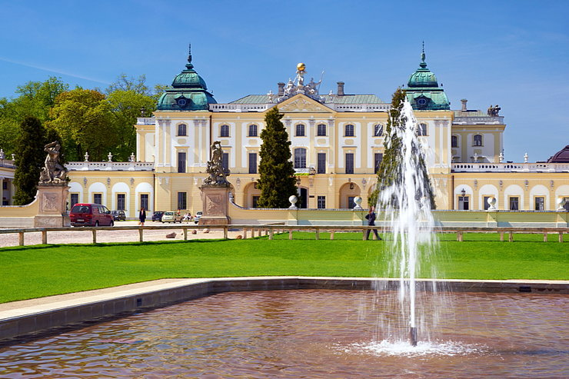
Branicki Palace
Historic Palace in Białystok, one of the best preserved aristocratic residences in the late Baroque style . The palace was destroyed in 1944, rebuilt in the 1946-1960. Since the end of World War II it’s located in Medical Akedamy.

Slide 11
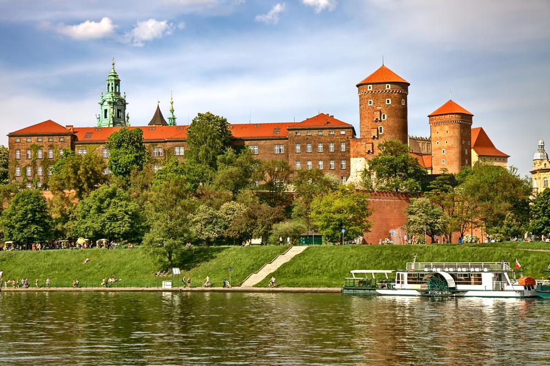
Wawel Castle
From 11th to 14th century castle was state of the prince and the royal and political center of the Polish state.This’s castle with historic character located on Wawel Hill in Krakow. It’s the largest and most important museum in Poland.

Slide 12
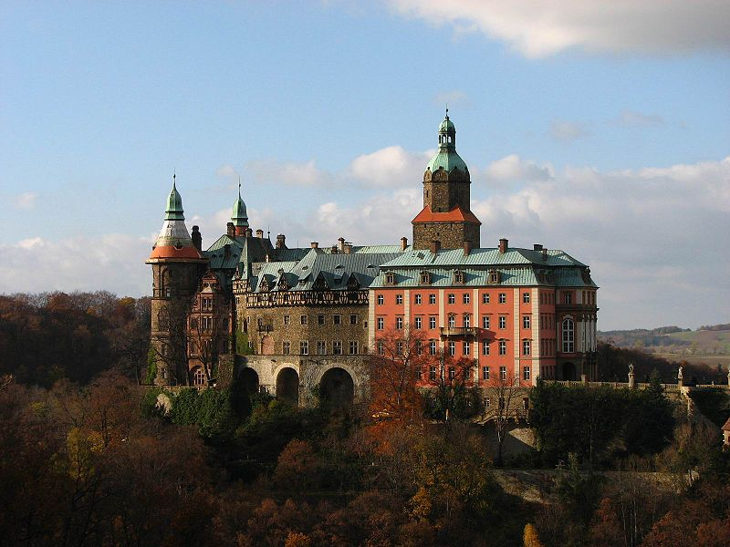
Ksiaz Castle
This's one of the biggest castles in Europe. It's the third biggest castle in Poland and the biggest one in South Silesia. The castle was built in 1288-1292 under the Prince Bolko I the Strict. Today, after many changes and new additions, the castle has over 400 rooms and is characterized by many different styles.

Slide 13
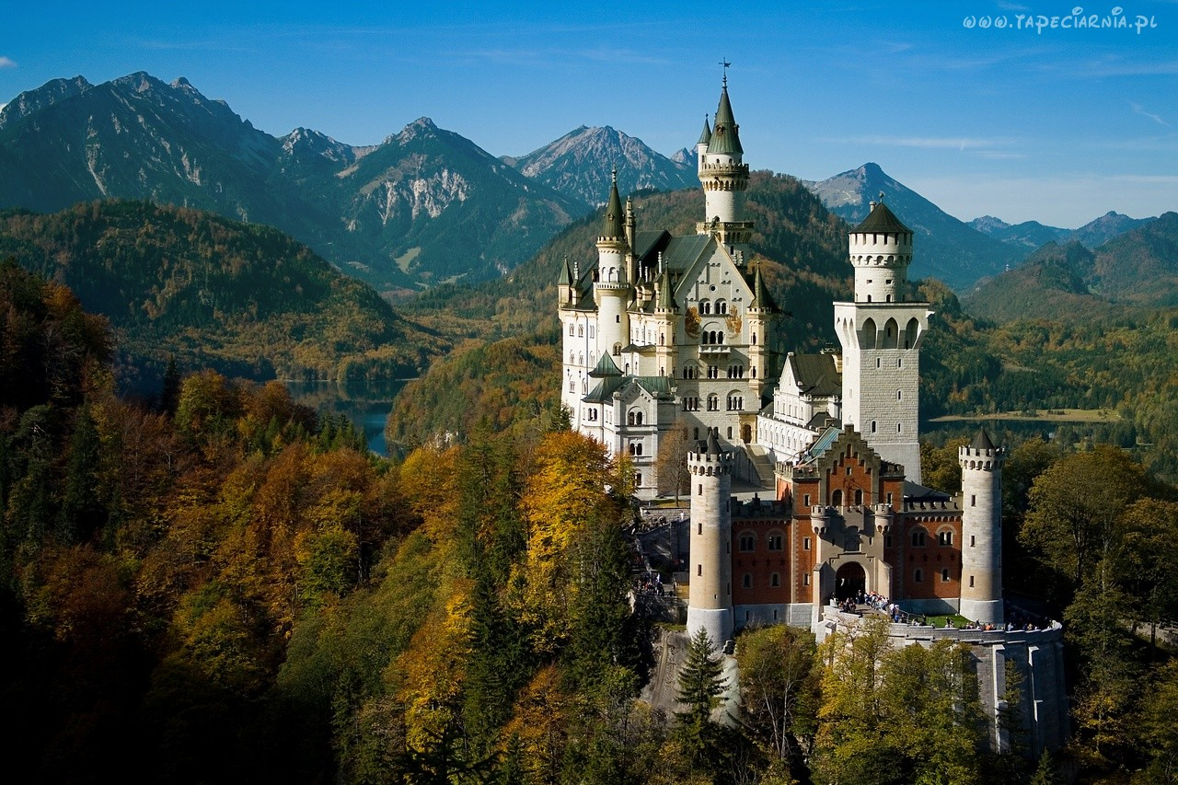
The End ☺

